Slide 1
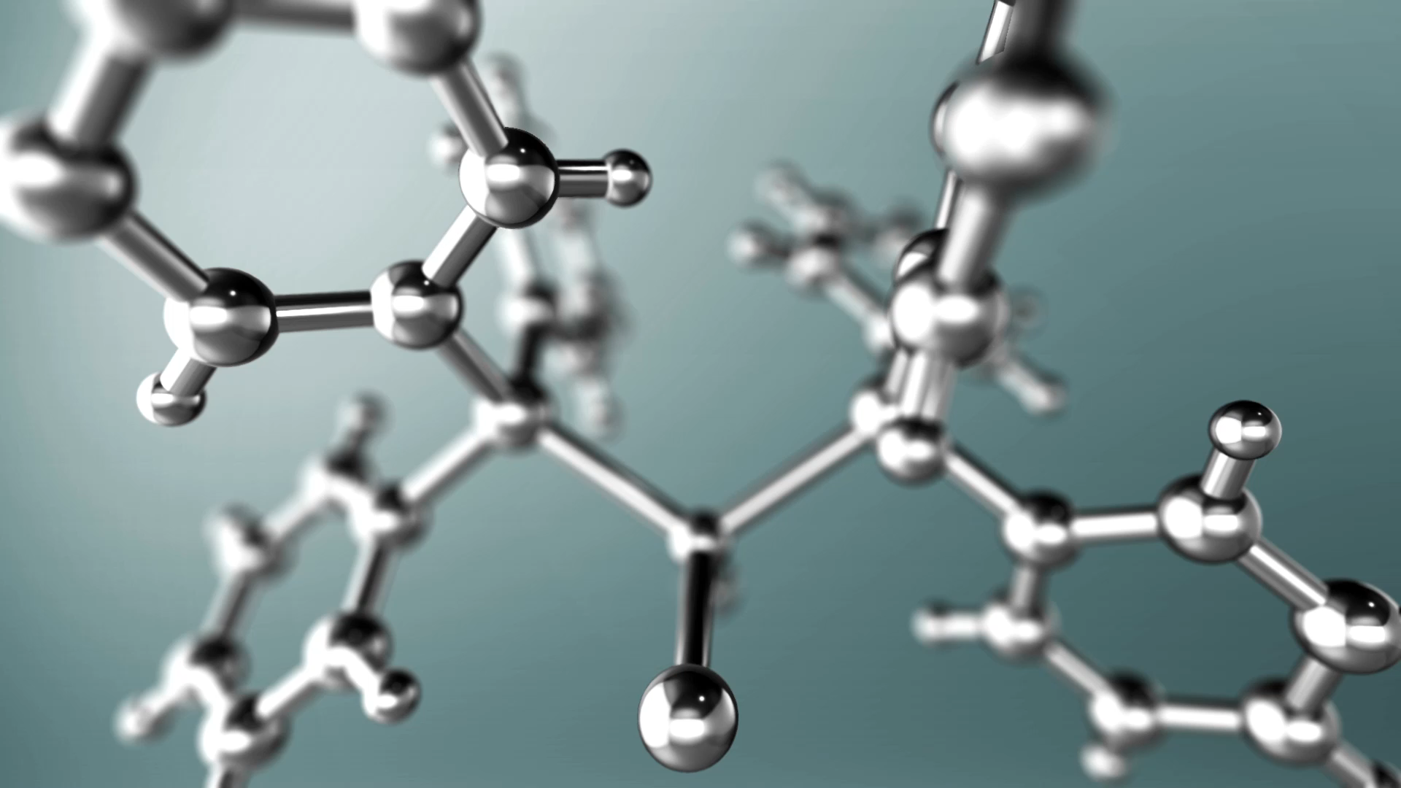
QSAR (Quantitative Structure Activity Relationships) Biodegradation
Group 6
Yuntian Luo (Jacky)

Slide 2
Brief Description
Nature of the data
Why it’s important to analyze
How it was collected: NITE
Imbalance: ready biodegradable: 356; not ready biodegradable: 699
Imbalance ratio: RB:NRB = 356:699 ≈ 1:2
N = 1055
P = 41
features

Slide 3
Sample descriptors
1) SpMax_L: Leading eigenvalue from Laplace matrix
2) J_Dz(e): Balaban-like index from Barysz matrix weighted by Sanderson electronegativity
3) nHM: Number of heavy atoms
4) F01[N-N]: Frequency of N-N at topological distance 1
5) F04[C-N]: Frequency of C-N at topological distance 4
6) NssssC: Number of atoms of type ssssC
7) nCb-: Number of substituted benzene C(sp2)
8) C%: Percentage of C atoms
9) nCp: Number of terminal primary C(sp3)
10) nO: Number of oxygen atoms

Slide 4
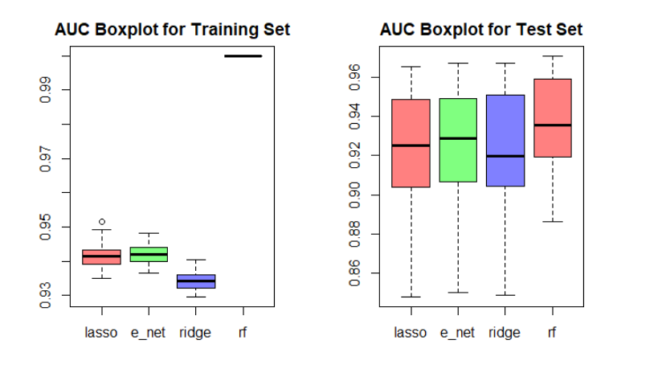
Boxplots of the 50 AUCs (Train and Test)

Slide 5
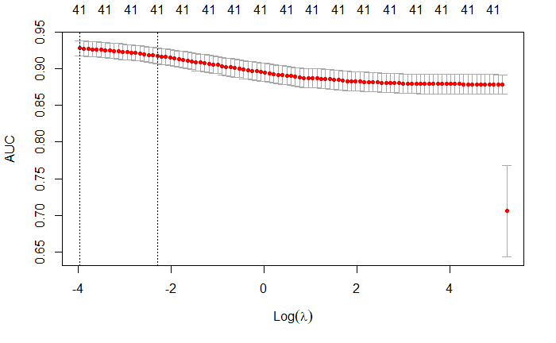
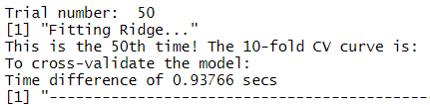
10-Fold CV Curves for 3 models and the Time

Slide 6
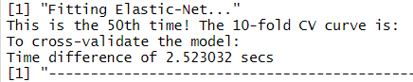
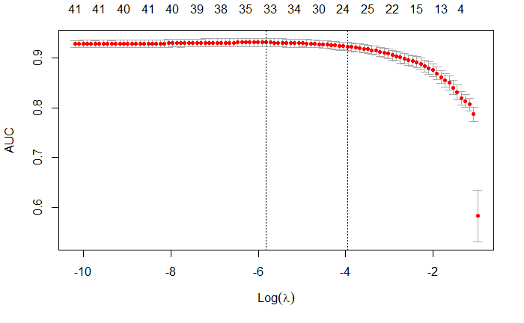
10-Fold CV Curves for E-Net and the Time

Slide 7
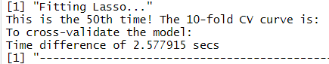
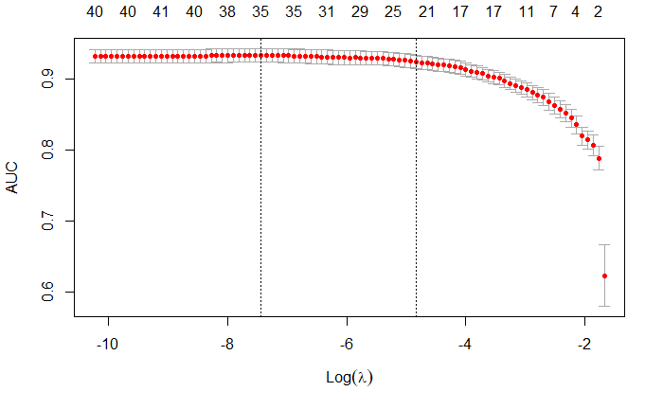
10-Fold CV Curves for Lasso and the Time

Slide 8
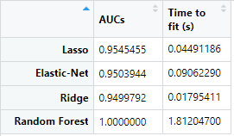
All the data – time it took and AUCs

Slide 9
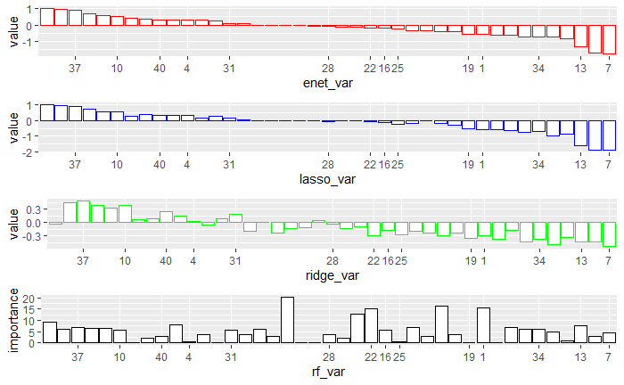
Bar-plots of the standardized estimated coefficients
37) Psi_i_A: Intrinsic state pseudoconnectivity index - type S average
7) nCb-: Number of substituted benzene C(sp2)

Slide 10
Concluding Remarks
In general, according to AUCs three models all perform really well
Ridge took way less time (to fit or cv), but performance is not bad
Probably not much collinearity since e-net doesn’t do much better
Random forest takes much more time and overfitted

